Slide 1

Domain: MATLAB
Technology: COMMUNICATION
AN IMPROVED ENERGY-EFFICIENT CLUSTERING PROTOCOL
TO PROLONG THE LIFETIME OF THE WSN-BASED IOT

Slide 2
Index
Abstract
Objective
Introduction
Literature review
Existing Method
Disadvantages
Problem Statement
Proposed method
Advantages
Hardware and Software Requirements
Results
Conclusion
References

Slide 3
Abstract
The Internet of Things relies heavily on wireless sensor networks (WSNs) (IoT). However, the energy resources of sensor nodes in a WSN-based IoT network are restricted. By grouping nodes into clusters to reduce the transmission distance between sensor nodes and base stations, a clustering protocol offers an effective method for ensuring node energy savings and extending network lifespan (BS). Current clustering protocols, on the other hand, have problems with the clustering mechanism, which has a negative impact on their efficiency. We suggest an enhanced energy-efficient clustering protocol (IEECP) in this paper to extend the lifespan of WSN-based IoT devices. The proposed IEECP is divided into three parts. For the overlapping balanced clusters, an optimum number of clusters is first calculated. The balanced-static clusters are then developed using a tweaked fuzzy C-means algorithm in combination with a mechanism to minimise and balance the sensor nodes' energy consumption. Finally, cluster heads (CHs) are chosen in optimal locations by rotating the CH function among cluster members using a new CH selection-rotation algorithm that combines a back-off timer mechanism for CH selection and a rotation mechanism for CH rotation. The suggested protocol, in particular, eliminates and balances energy consumption . The proposed protocol, in particular, reduces and balances node energy usage by optimising clustering structure, and IEECP is ideal for networks with a long lifespan.

Slide 4
OBJECTIVE:
The Improved energy-efficient clustering protocol (IEECP)is the proposed protocol reduces and balances the energy consumption of nodes by improving the clustering structure, IEECP is suitable for networks that require a long lifetime.

Slide 5
Introduction:
WSN, an inexpensive legacy system, has been applied in several fields, such as industrial control, environmental monitoring, military surveillance, and intelligent transportation systems , providing large-scale physical data that can be further utilized. Thus, by integrating the IOT and WSN applications, no massive paradigm shift is needed .WSN-based IOT is advantageous for its convenient deployment and low cost. Furthermore, it can function independently in harsh or high-risk places where human presences not possible. However, WSNs have defects that need to be addressed. The network lifetime problem is the mainchallenge in WSN . The sensor's lifetime is only related to its batteries, which are difficult or impossible to replace or recharge due to the rugged environments where they are operating This problem undermines the integration of the WSN into IOT, elevating the costs of new technology. Accordingly, prolonged network lifetime is considered as a major challenge in the WSN- based IOT. Consequently, to prolong the network's life-time and improve energy consumption, a clustering approach is used in the WSN. The clustering protocol, where the sensor nodes are divided into small clusters, is an effective technique to reduce energy consumption and prolong network lifetime by avoiding long-distance communication .Each cluster employs one node as a cluster head (CH) that has duties more than member nodes (MNs). Practically, each MN in the cluster transmits its sensing data to its CH, and then the CH transmits these data to BS via a single-hop or multi-hop manner.

Slide 6
Literature review:
S. NO | Journal Type with year | Authors | Title | Outcomes
1 | IEEE Access, vol. 5, pp. 1846918479, 2017. | J. Shen, A. Wang, C. Wang, P. C. K. Hung, and C.-F. Lai | An efficient centroid-based routing protocol for energy management in WSN-assisted IoT | Studied about the centroid based routing protocol
2 | Int. J. Electr. Comput. Eng., vol. 9, no. 1, pp. 439444, 2019. | V. Reddy and P. Gayathri, | Integration of Internet of Things with wireless sensor network | Studied about IOT with WSN
3 | IEEE Sensors J., vol. 15, no. 5, pp. 29842992, May 2015. | H. P. Gupta, S. V. Rao, A. K. Yadav, and T. Dutta | Geographic routing in clustered wireless sensor networks among obstacles | Studied about clustered WSN
4 | EURASIP J. Wireless Commun. Netw., vol. 2018, no. 1, pp. 111, Dec. 2018. | Q. Wang, S. Guo, J. Hu, and Y. Yang, | Spectral partitioning and fuzzy C-means based clustering algorithm for big data wireless sensor net- works | Studied about the fuzzy C-means based clustering algorithm
5 | Wire-less Pers. Commun., vol. 98, no. 1, pp. 16051635, Jan. 2018. | S. Dehghani, B. Barekatain, and M. Pourzaferani, | An enhanced energy- aware cluster-based routing algorithm in wireless sensor networks | Studied about cluster-based routing algorithm

Slide 7
Existing methods:
The first proposed clustering protocol is the LEACH(LOW ENERGY ADAPTIVE CLUSTERING HIERARCHY) protocol . The main idea is to choose the CH in a clustered manner at each round and then have the nodes join the closest CH to form a dynamic cluster. This network topology is built on the chosen CHs, which is inefficient due to the lack of consideration for node residual energy. Furthermore, prioritising CH selection results in the forming of complex clusters at each round, resulting in an increase in energy overhead due to cluster formation after each re-selection phase for CHs
Another version of the protocol is a LEACH-centralized protocol (LEACH-C) , where the optimal number of clusters K is determined based on a mathematical model.

Slide 8
Disadvantages in Existing methods:
1. LEACH does not give any idea about the number of cluster heads in the network.
2. One of the biggest disadvantage of LEACH is that when due to any reason Cluster head dies, the cluster will become useless because the data gathered by the cluster nodes would never reach its destination i.e. Base Station.
3.Some cluster heads at the center of the cluster and some cluster heads may be in the edge of the cluster; this phenomenon can cause an increase in energy consumption and have great impact on the performance of the entire network.
4. CH selection is the most difficult part of dynamic clustering.
5.Inaccurate determination of the optimal number of clusters when using current mathematical models because the distance to the CH has not been estimated correctly.
6. In LEACH-C nodes, energy overhead persists, and the round trip is time-consuming throughout the CH selection process. The main disadvantage in existing method is the unbalanced energy consumption.
.

Slide 9
Problem Statement:
WSNs have defects that need to be addressed. The network lifetime problem and unbalanced energy consumption is the main challenge in WSN.
The sensor's lifetime is only related to its batteries, which are difficult or impossible to replace or recharge due to the rugged environments where they are operating, prolongednetwork lifetime is considered as a major challenge in theWSN- based IOT.
Existing clustering protocols suffer from issues concerning the clustering structure that adversely affects the performance of these protocols.

Slide 10
Proposed method:
Improved energy-efficient clustering protocol (IEECP) The proposed protocol reduces and balances the energy consumption of nodes by improving the clustering structure, where IEECP is suitable for networks that require a long lifetime. The evaluation results prove that the IEECP performs better than existing protocols.
First, an optimal number of clusters is determined for the overlapping balanced clusters. Then, the balanced-static clusters are formed on the basis of a modified fuzzy C-means algorithm by combining this algorithm with a mechanism to reduce and balance the energy consumption of the sensor nodes. Lastly, cluster heads (CHs) are selected in optimal locations with rotation of the CH function among members of the cluster based on a new CH selection-rotation algorithm by integrating a back-off timer mechanism for CH selection and rotation mechanism for CH rotation.
The proposed protocol which consists of three parts: determination of the optimal number of clusters based on a modified mathematical model, formation of balanced clusters based on a modified Fuzzy C-means (M-FCM) and selection and rotation of the CH for clusters based on the CH selection-rotation algorithm (CHSRA).

Slide 11
Proposed method:
The FCM algorithm has been widely used in the clustering processes for WSN cluster formation. This algorithm was originally presented by Dunn . The goal of FCM is to form better clusters by reducing the summation of distances between the objects (N) and the cluster centers (C) by using the objective function. In WSN, the objects refer to nodes that are already distributed in the sensing area.
The proposed clustering algorithm is executed at the BS and consists of two phases: 1) initial cluster formation, which is based on the FCM, and 2) balanced cluster formation, which is based on the CM. In the initial cluster formation, the FCM is applied to form the clusters as shown in the algorithm, and then the process shifts to the second phase. The balanced cluster formation phase consists of two subphases. The rst sub phase consists of the following steps:1) The cluster threshold (Thcluster ) is determined. 2) Clusters are sorted based on size.

Slide 12
Advantages of Proposed method:
1.Proposed Protocol IEECP Prolongs the WSN-based IoT lifetime.
2. The proposed protocol reduces and balances the energy consumption of nodes by improving the clustering structure,
3. The evenly distribution of the selected CHs in the monitoring area with low overhead
in the selection process,
4.The optimal number of clusters are determined.
5. IEECP gives idea about the number of cluster heads in the network
6.It balances the distance among CHs in adjacent clusters by adopting the routing information in the CH selection process that leads to balanced energy consumption for CHs. The CH rotation process that relies on a threshold value is possible.
7.The CHSRA ensures the balance in energy consumption for the successive CHs of the cluster. So the Proposed Protocol IEECP gives balanced energy consumption.

Slide 13
Applications:
1.Industrial control
2.Environmental monitoring,
3. Military surveillance,
4.Intelligent transportation systems and medical field.
5.Furthermore, it can function independently in harsh or high-risk places where human presence is not possible
6.Disaster relief operations.
7.Biodiversity mapping
8.monitoring of temperature, pressure, and humidity

Slide 14
Hardware and Software Requirements:
Hardware & Software Requirements:
Software: Matlab R2018a.
Hardware:
Operating Systems:
• Windows 10
• Windows 7 Service Pack 1
• Windows Server 2019
• Windows Server 2016
Processors:
Minimum: Any Intel or AMD x86-64 processor
Recommended: Any Intel or AMD x86-64 processor with four logical cores and AVX2 instruction set support
Disk:
Minimum: 2.9 GB of HDD space for MATLAB only, 5-8 GB for a typical installation
Recommended: An SSD is recommended a full installation of all Math Works products may take up to 29 GB of disk space
RAM:
Minimum: 4 GB
Recommended: 8 GB

Slide 15
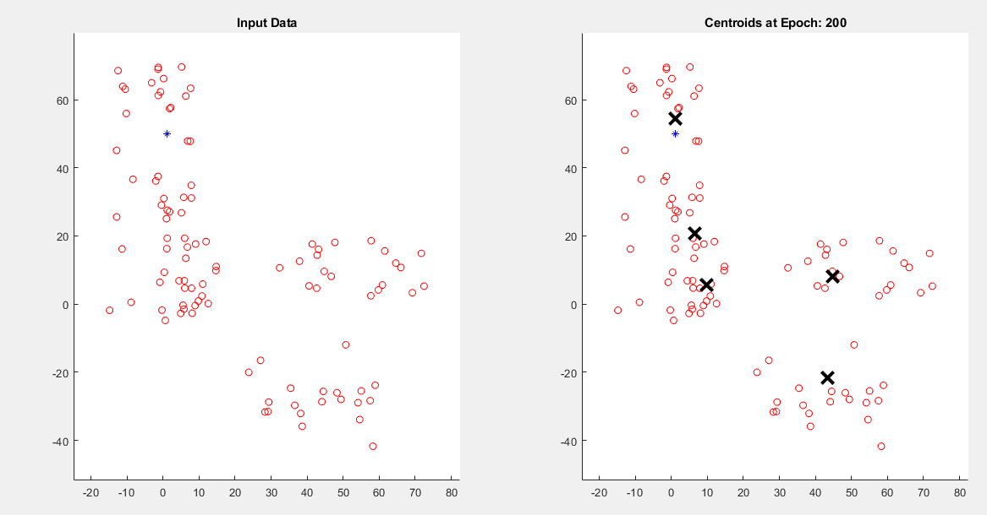
Results and Discussions:
Figure :Formation of clusters according to M-FCM.

Slide 16
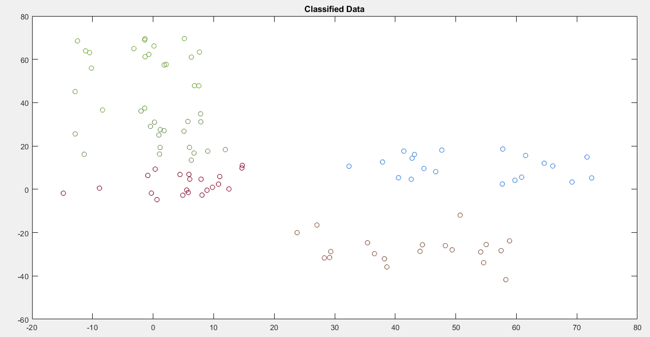
Results and Discussions:
Figure :Classified Data

Slide 17
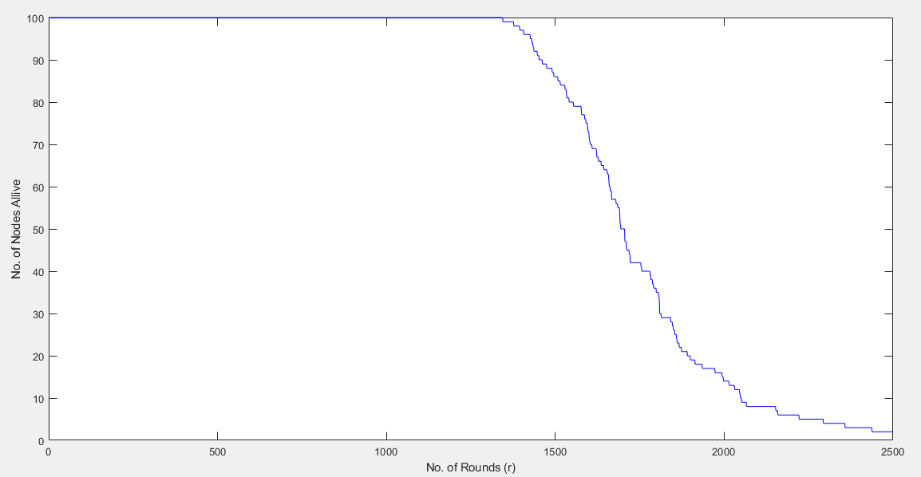
Results and Discussions:
Figure : Number of live nodes of the first scenario.

Slide 18
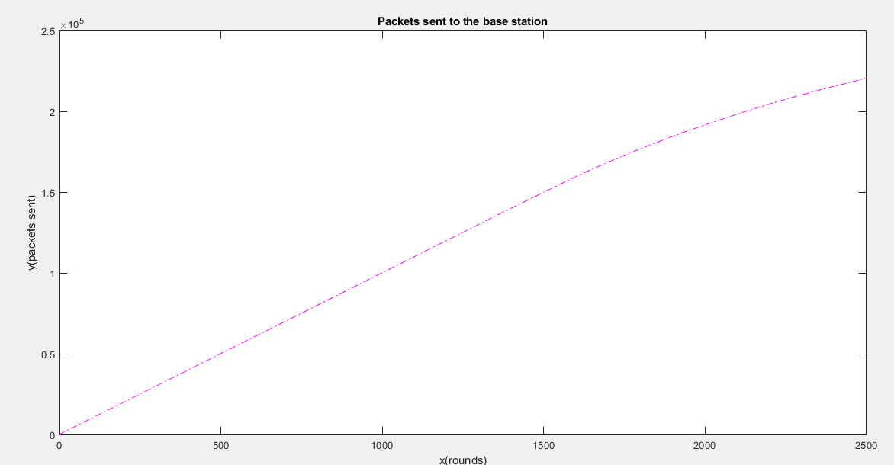
Results and Discussions:
Figure :Number of messages received by BS

Slide 19
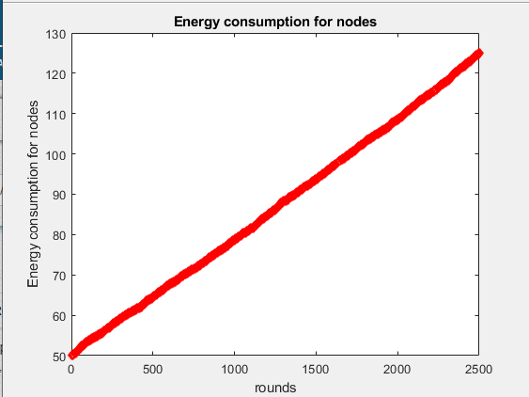
Results and Discussions:
Figure : Energy consumption for effective network

Slide 20
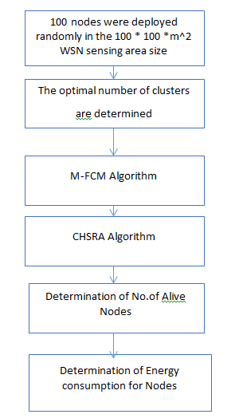
Flow of the proposed protocol

Slide 21
CONCLUSION:
In this significant work, we propose an improved energy-efficient clustering protocol (IEECP) to prolong the lifetime of WSN-based IoT network through overcoming the problems of the clustering structure that adversely affect the protocol performance. Evidently, the proposed protocol reduces and balances the energy consumption of nodes by improving the clustering structure. Hence, the IEECP is deemed suitable for networks that require a longer lifetime. In general, the results yield that the IEECP performs better than the existing protocols. Our proposed protocol will be a beneficial contribution to the enhance that will enhance the daily operations in many areas of life, which utilize WSN in the IoT world. The energy consumption of the network is analyzed to compute the optimal number of clusters based on the distance to the CH in the case of the overlapping clusters.

Slide 22
References:
[1] J. Shen, A. Wang, C. Wang, P. C. K. Hung, and C.-F. Lai, ``An efcient centroid-based routing protocol for energy management in WSN-assisted IoT,'' IEEE Access, vol. 5, pp. 1846918479, 2017.
[2] V. Reddy and P. Gayathri, ``Integration of Internet of Things with wireless sensor network,'' Int. J. Electr. Comput. Eng., vol. 9, no. 1, pp. 439444, 2019.
[3] H. P. Gupta, S. V. Rao, A. K. Yadav, and T. Dutta, ``Geographic routing in clustered wireless sensor networks among obstacles,'' IEEE Sensors J., vol. 15, no. 5, pp. 29842992, May 2015.
[4] Q. Wang, S. Guo, J. Hu, and Y. Yang, ``Spectral partitioning and fuzzy C-means based clustering algorithm for big data wireless sensor net- works,'' EURASIP J. Wireless Commun. Netw., vol. 2018, no. 1, pp. 111, Dec. 2018.
[5] S. Dehghani, B. Barekatain, and M. Pourzaferani, ``An enhanced energy- aware cluster-based routing algorithm in wireless sensor networks,'' Wire-less Pers. Commun., vol. 98, no. 1, pp. 16051635, Jan. 2018.

Slide 23
IEECP provides an efficient solution to ensure energy saving of nodes and prolong the network lifetime by organizing nodes into clusters to reduce the transmission distance between the sensor nodes and base station(BS).
Steps followed:
1.an optimal number of clusters is determined for the overlapping balanced clusters. (71 line)
2.Then, the balanced-static clusters are formed on the basis of a modified fuzzy C-means algorithm .
modified fuzzy C-means algorithm (M-FCM) that result from a combination of the FCM algorithm with a centralized mechanism, by combining this algorithm with a mechanism to reduce and balance the energy consumption of the sensor nodes. (72-120lines)
3.Lastly, cluster heads (CHs) are selected in optimal locations with rotation of the CH function among members of the cluster based on a new CH selection-rotation algorithm by integrating a back-off timer mechanism for CH selection and rotation mechanism for CH rotation.(130-167lines)
4) Balancing the communication distance among the CHs in the network based on a new objective function for the back-off mechanism, and
5) Balancing the life of the selected CHs in the cluster based on a new dynamic threshold.

Slide 24
The CH selection and rotation issues have gained a great interest in researchers. Furthermore, in this study, a new algorithm has been proposed by integrating the back-off timer mechanism for CH selection with a rotation mechanism called CHSRA. In this algorithm, the CH is selected accurately by using a new objective function. Furthermore, the CH function is rotated among the members of the cluster based on a new rotation mechanism, where it is executed without anycontribution to the BS.The goal of CHSRA is to reduce the overhead by selecting he CH within members of the cluster only. Furthermore, It balances the distance among CHs in adjacent clusters by adopting the routing information in the CH selection process that leads to balanced energy consumption for CHs. Besides, the CHSRA ensures the balance in energy consumption for the successive CHs of the cluster. The CHSRA comprises twophases:
1) CH selection phase implemented by the back-off timer mechanism, and
2) CH rotation phase implemented by the dynamic threshold mechanism.
Iteration Rounds are for finding the current sensing values and to know the number of alive nodes i.e for particular no of rounds ,how many alive nodes are there(169-411) ,and this rounds are taken for knowing how many packets were sent to Base Station, same applies for energy consumption for nodes.(415-698),here we took 2500 rounds.

